Slide 1






Lecture 1:
Introduction to DOM
Course - Web Development - II
-By
Instructor Name
welcome@krmangalam.edu.in
Sohna Road,Gurugram,Haryana 122103

Slide 2

| Table of Contents
What is DOM?
DOM Tree Structure
HTML vs DOM
References.
The End.

Slide 3

|
When you turn on the light using a switch, do you go inside the wall to move the wires yourself?

Slide 4
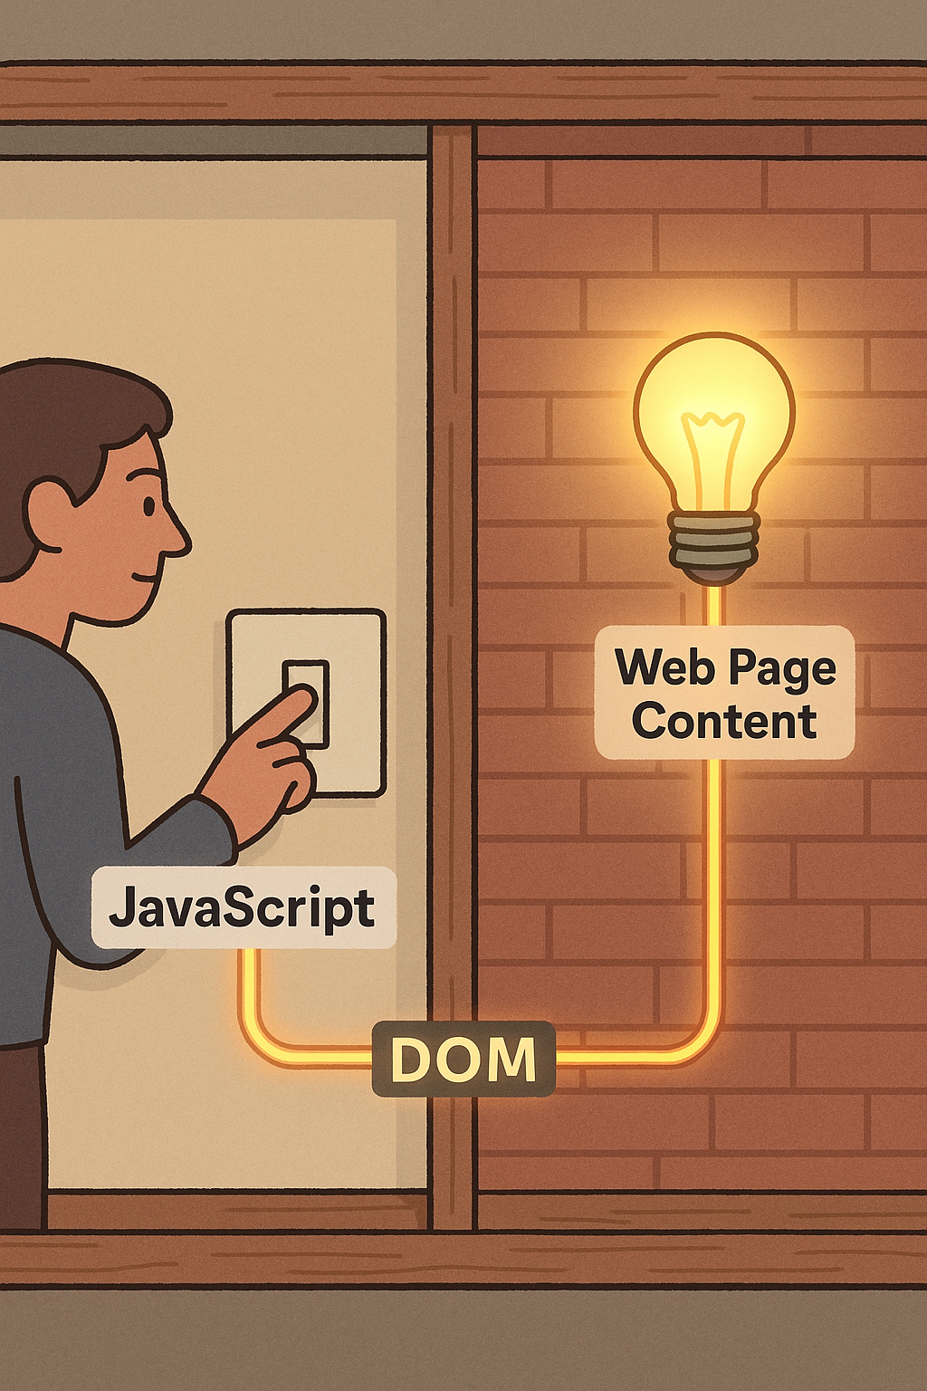
|
When you turn on the light using a switch, do you go inside the wall to move the wires yourself?
You don’t touch the wiring directly — you use a switch, and the wiring does the rest to turn the light on or off.
The light bulb = the content (HTML)
The switch = JavaScript
The wiring = the DOM
The DOM is like the wiring in your house — it connects the switches (JavaScript) to the lights (web content), so things actually respond.

Slide 5
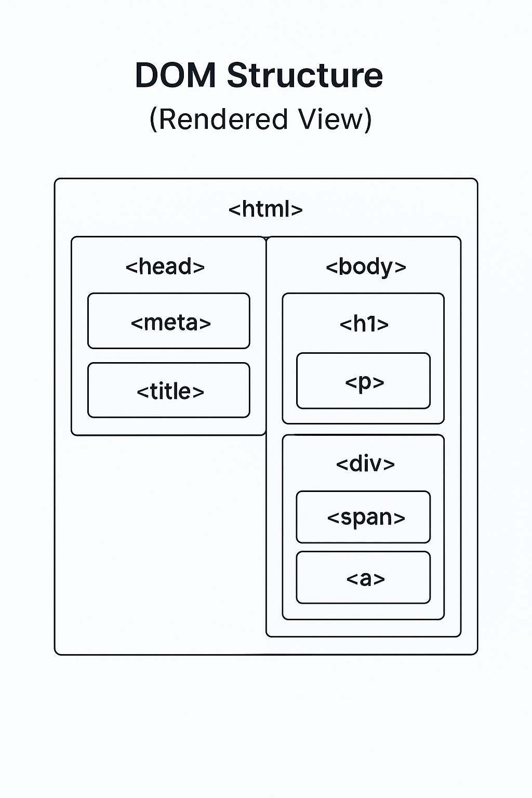
| What is DOM?
DOM Stands for Document Object Model.
The DOM is a tree-like structure that the browser creates from your HTML page.
It represents everything on the webpage — text, buttons, images, sections — as objects that JavaScript can access and control.

Slide 6
| Why We Need DOM?
HTML creates the structure of a web page, but once the page loads, it's just static. You can't change content, read input values, or respond to user actions with HTML alone.
Example: You can write a button in HTML, but without the DOM, JavaScript has no way to know when it's clicked or what to do after.
The DOM lets JavaScript:
Read and change content on the page
React to user actions (clicks, typing, scrolling)
Create new elements or remove old ones
Build dynamic, interactive web pages without reloading

Slide 7
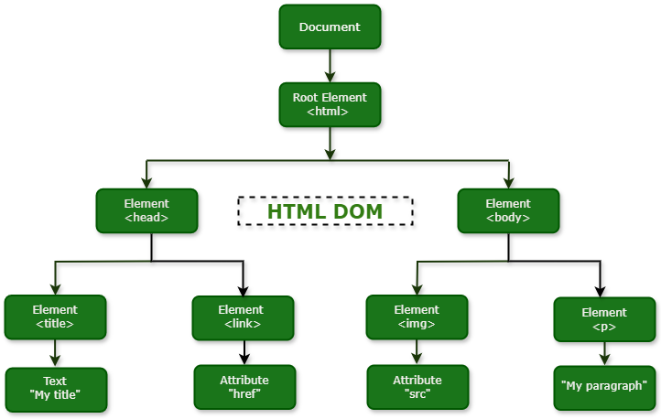
| DOM Tree Structure

Slide 8
| DOM Tree Structure : Explanation
Root Level – Document Object
The topmost node is Document.
It represents the entire HTML page loaded in the browser.
<html> – Root Element
The Document points to the <html> element, which is the root of the HTML structure.
All content on the page is nested inside <html>.
Inside <html> – Two Main Branches
<head>: Contains metadata and resources.
<body>: Contains visible content of the page.

Slide 9
| DOM Tree Structure
HEAD Section Breakdown
<head> → <title>
<title> is a child of <head>.
It contains text: "My title" (this appears in the browser tab).
<head> → <link>
<link> is another child of <head>.
It includes an attribute: "href" — typically used to link CSS files.

Slide 10
| DOM Tree Structure
BODY Section Breakdown
<body> → <img>
<img> is a child of <body>.
It has an attribute: "src" — which defines the image source.
<body> → <p>
<p> is also a child of <body>.
It contains a text node: "My paragraph" — this appears as visible paragraph content.

Slide 11
| DOM vs HTML
Although closely related, HTML and DOM are not the same. They serve different purposes in web development
Aspect | HTML | DOM
Type | Markup Language | Programming Interface
Nature | Static | Dynamic
Purpose | Structure and content | Manipulation and interaction
Modification | Cannot change after load | Can be changed at runtime
Used by | Browser | JavaScript
Event handling | Not supported | Fully supported

Slide 12

| Check Your Understanding
Question : What does DOM stand for in the context of web development?
Options : a) Digital Ordinance Mandate
b) Document Object Model
c) Data Object Module
d) Document Orientation Marker
Answer : c) Document Object Model
Explanation:
The DOM is a programming interface for web documents. It represents the page so that programs can change the document structure, style, and content.

Slide 13
| References
MDN Web Docs : Comprehensive and official documentation for JS. 🔗https://developer.mozilla.org/en-US/docs/Web/JavaScript
W3Schools – JS Tutorial : Beginner-friendly JS tutorials with examples and interactive editors. 🔗 https://www.w3schools.com/js/
JavaScript.info - A comprehensive tutorial-style website that covers core JavaScript concepts in depth.
🔗https://javascript.info/

Slide 14
Thanks
For
Watching
Course - Web Development - II
welcome@krmangalam.edu.in
Sohna Road,Gurugram,Haryana 122103

